Slide 1



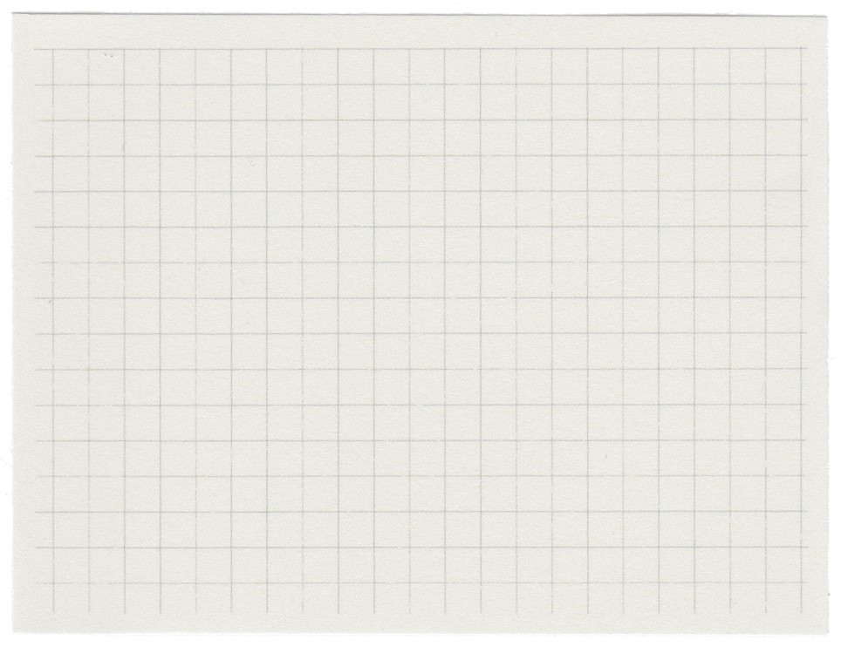



STRATEGY PATTERN

Slide 2
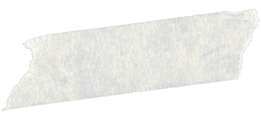





TABLE OF CONTENT
WHY?
HOW?
WHAT?

Slide 3




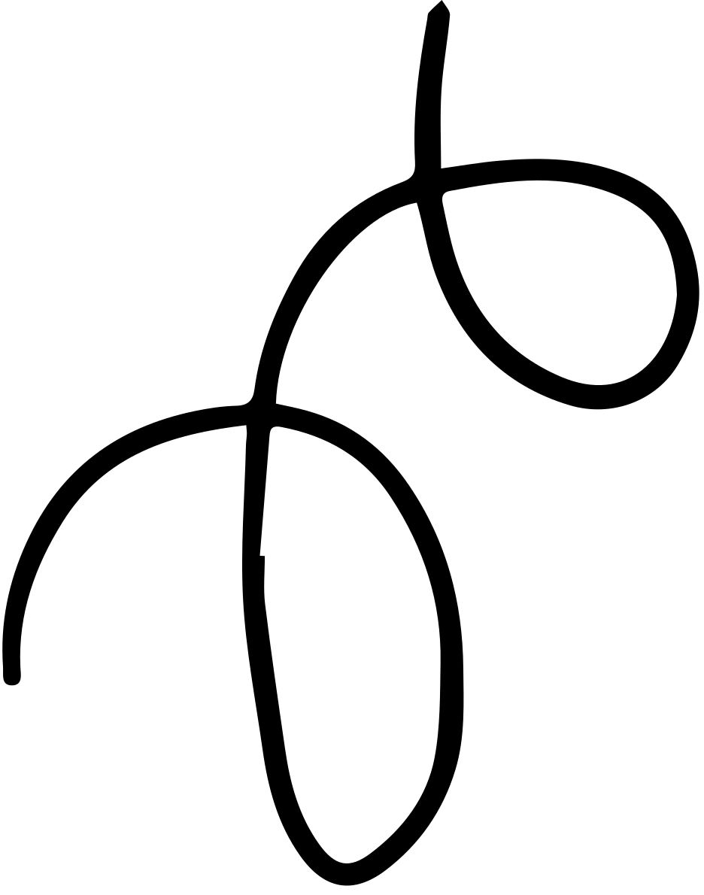
WHY?

Slide 4
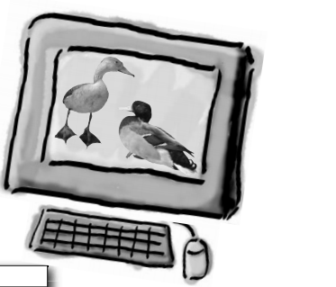
Introduction to SimUDuck app

Slide 5
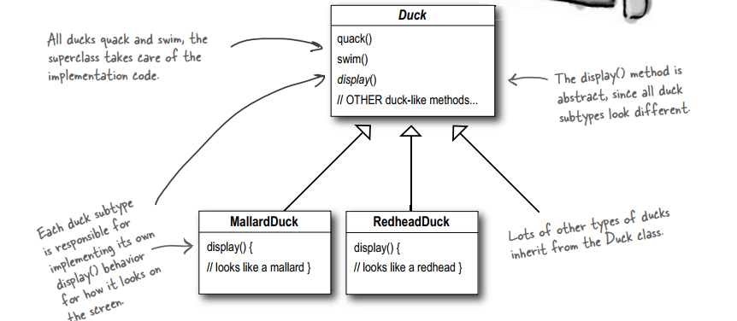

Slide 6
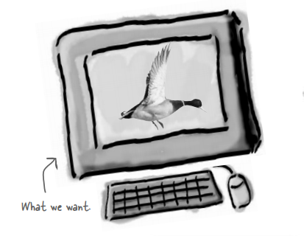
But now we need the ducks to FLY

Slide 7
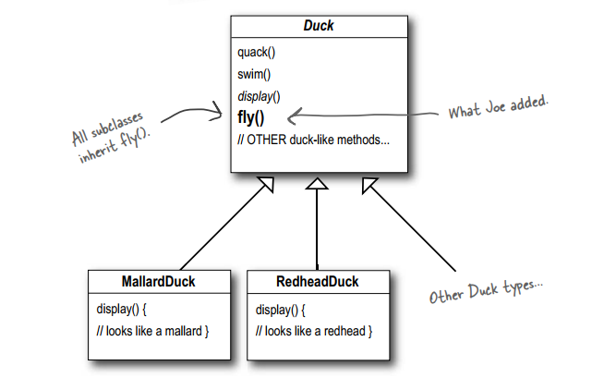
It is that simple.

Slide 8
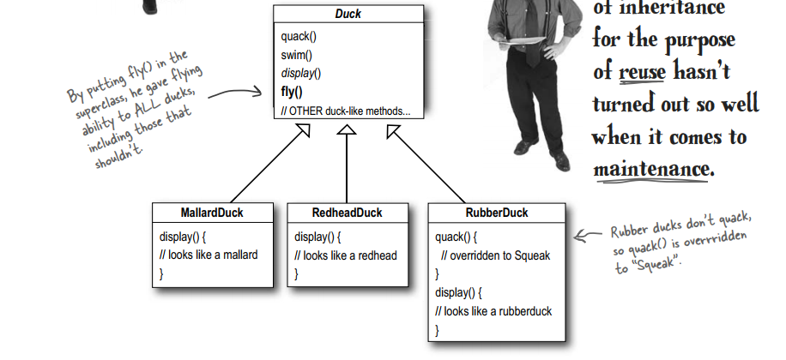
But something went horribly wrong...

Slide 9
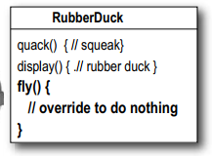
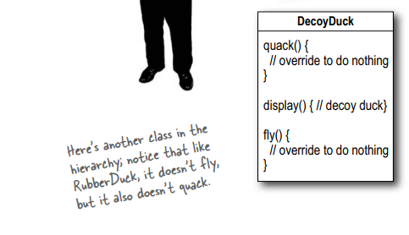
b) Inheritance

Slide 10
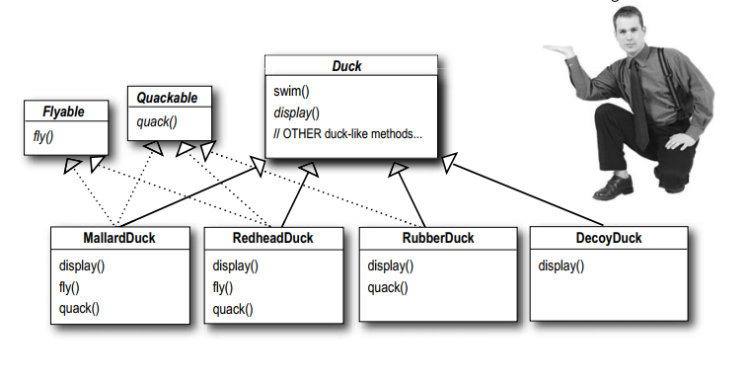
c) Interface.

Slide 11
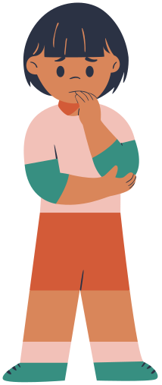
2. WHAT?

Slide 12
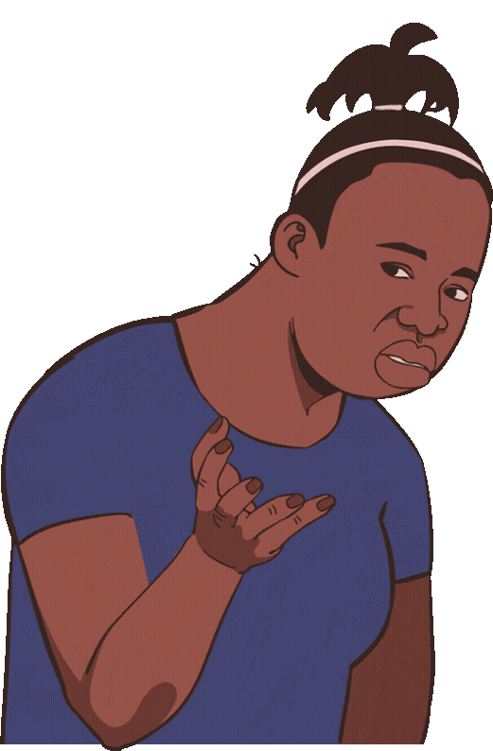
DESIGN PRINCIPLE

Slide 13
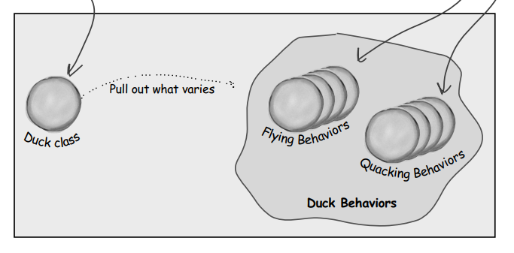

Slide 14

3. HOW?

Slide 15
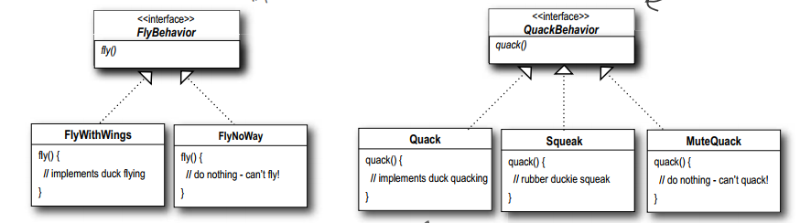
Implementing the Duck Behaviors

Slide 16
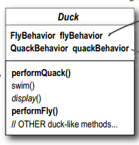
Integrating the Duck Behavior

Slide 17
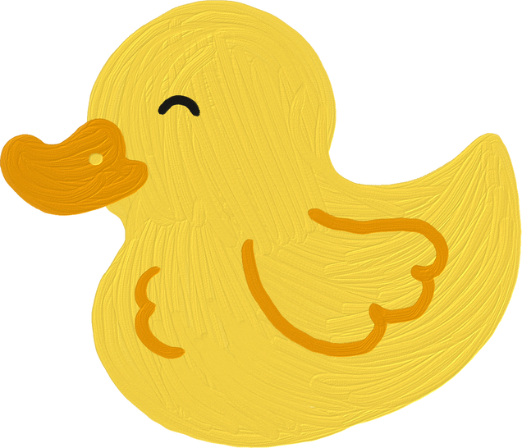
THANKS FOR LISTENING

